Slide 1
Local Administrator Guide

Slide 2


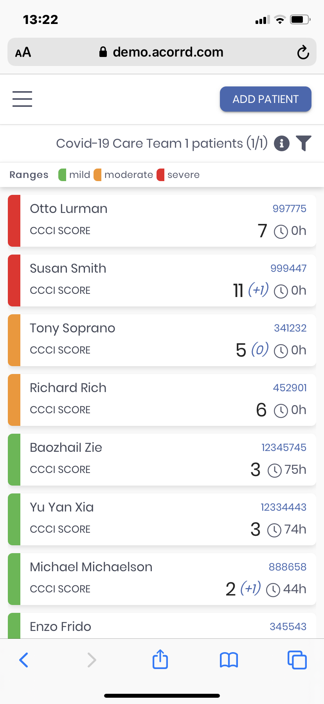
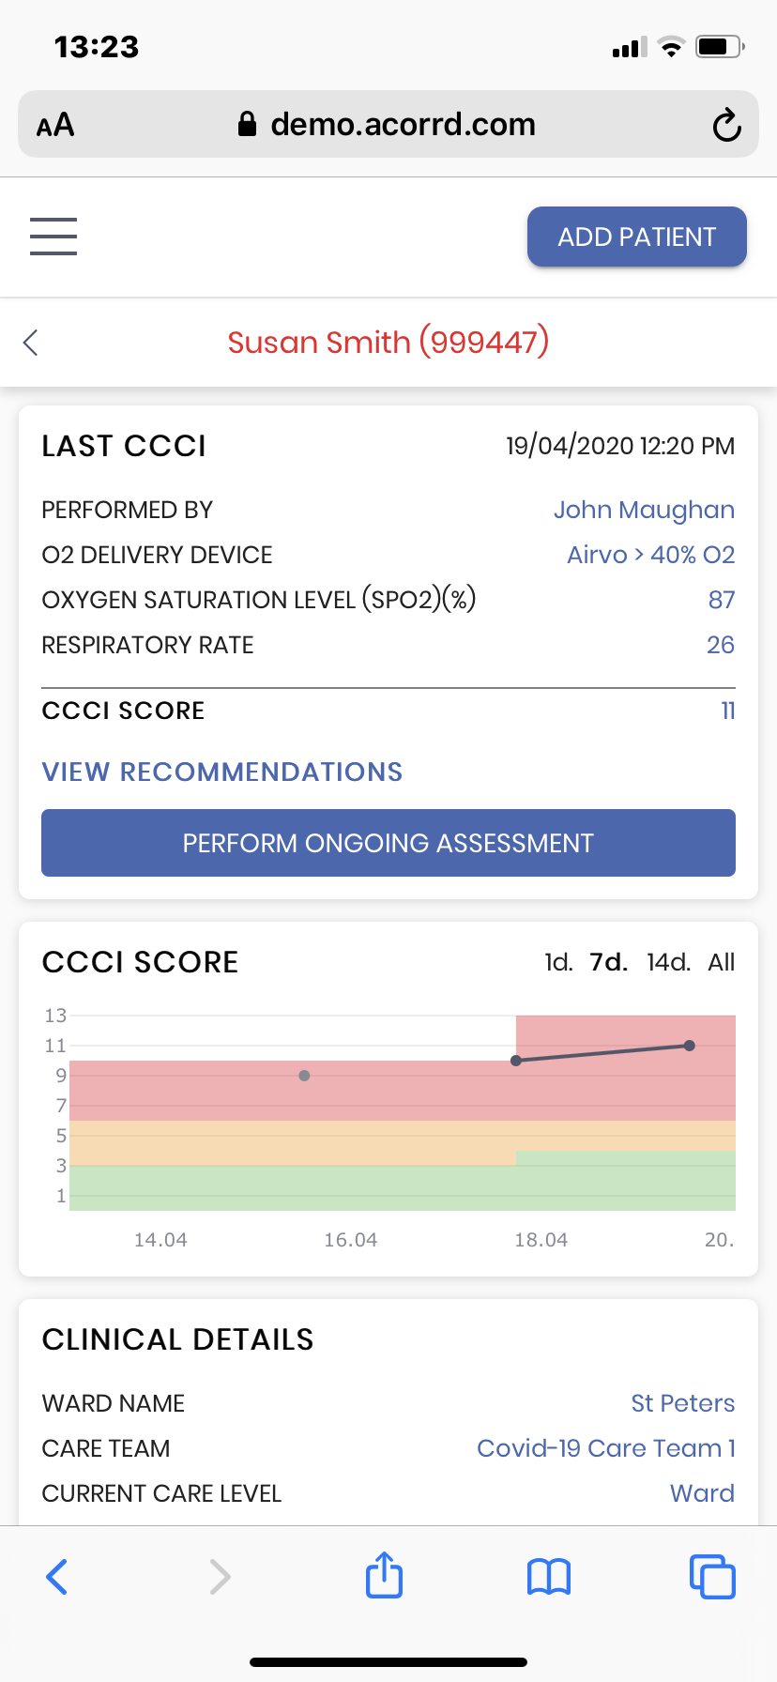
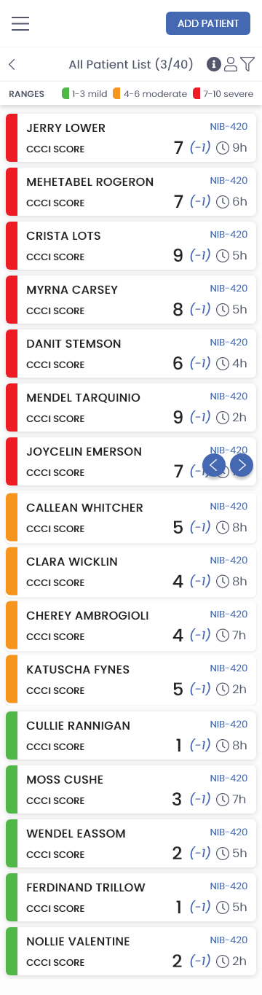
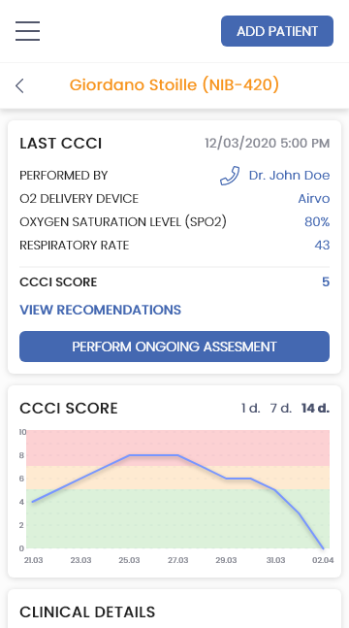
What is Enodatis for Covid-19?
  Clinical tool for respiratory care of COVID-19 patients
  Is a response to the need for tools that enable hospitals to optimise and scale acute respiratory care delivery
  Is a web application accessible via mobile phone
  Defines a novel measure of patient status called the COVID Critical Care Index (CCCI)
CCCI has been designed collaboratively by a team led by
Prof. Richard Costello including respiratory specialist clinicians and researchers from Beaumont, St. Vincent’s, St. James,
the Mater, and clinicians from S3 Connected Health.

Slide 3


Enodatis for Covid-19 Product Information
 | Enodatis for COVID-19 is a Class I Software as a Medical Device (SaMD) under the Medical Device Directive (93/42/EEC), Annex IX, Section III, Rule 12.
Intended Use | Enodatis for COVID-19 is a Clinical Decision Support aid to assist Healthcare Professionals in the provision of respiratory care for patients suffering from COVID-19.
 | The CCCI Assessment score is not valid for patient under 12 years of age.
 | Healthcare Professionals should exercise professional judgement using the information provided by Enodatis for COVID-19 in the provision of respiratory care for patients suffering from COVID-19. The CCCI score is calculated upon manual inputs into Enodatis for COVID-19. If the CCCI score is very different from the last assessment (trend is strongly up or down) then recheck the entries to ensure that the input data is correct before acting upon the Enodatis for COVID-19 recommendations.
 | https://servicedesk.enodatis.com
Warnings
Cautions

Slide 4
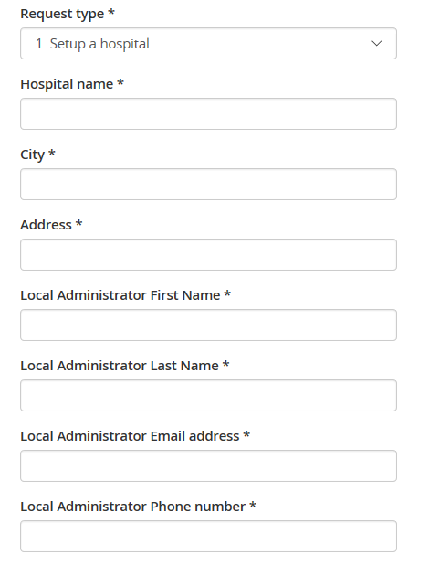
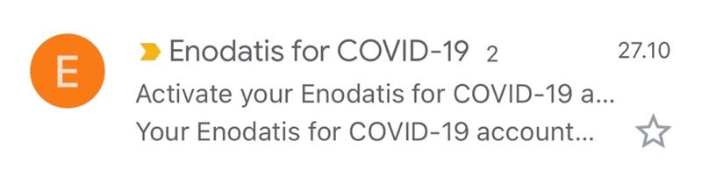
How do I register and access Enodatis for Covid-19?
1
2
3
Request Registration:
To use Enodatis for COVID-19, a hospital must be setup by the global service administrator.
To request registration for your hospital go to:
https://servicedesk.enodatis.com
Fill the registration request form:
Setup Local Admin Account:
Once verified by the ServiceDesk the nominated local administrator will be sent an email inviting them to register.
Local Admin should follow on screen instructions to specify a password and create their account on Enodatis for COVID-19.

Slide 5
What does the Enodatis for Covid-19 Local Admin do?
1
Setup Clinical Teams
Clinicians using Enodatis for COVID-19 are organised into teams. These teams reflect the real world assignment of clinicians to clinical teams typically managed by a clinical consultant.
2
Invite Healthcare Providers (HCPs) to Register
HCPs can only use Enodatis for COVID-19 if they are invited to do so by a local administrator. The local admin must verify the credentials of the people invited to register. Once verified the local admin issues an invitation to the HCP to register.
3
Invite additional Local Admins
A local admin can also invite other local admins so that the tasks can be shared among multiple people if necessary.
4
Configure hospital wards
The local admin sets up the hospital wards for their hospital.

Slide 6
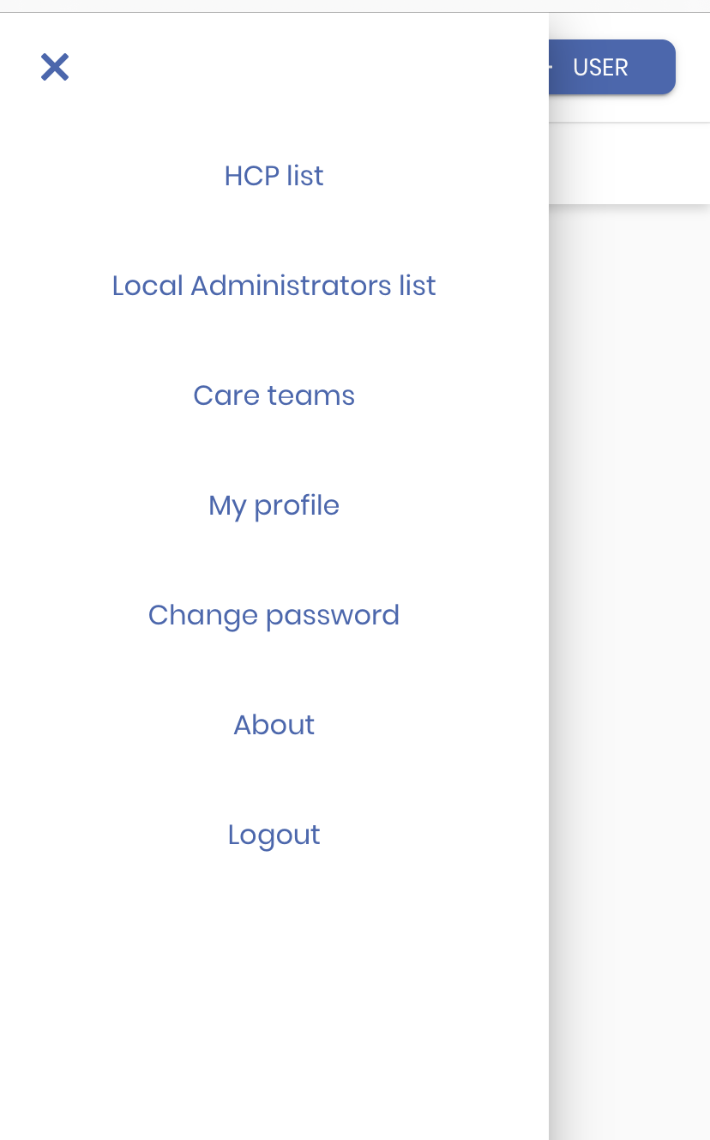
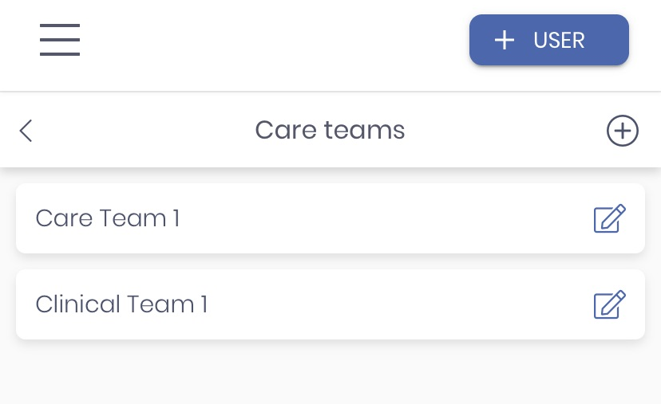
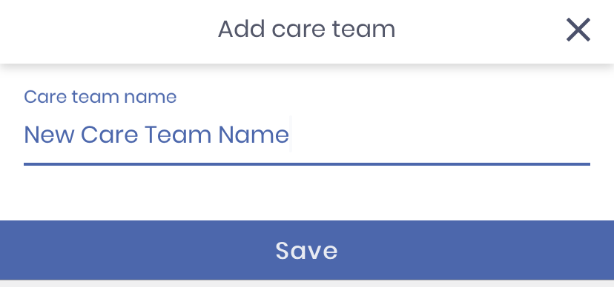
How do I Setup a Clinical Team?
Clinicians using Enodatis for COVID-19 are organised into teams. These teams reflect the real world assignment of clinicians to clinical teams typically managed by a clinical consultant.
Tap the Menu button ≡ on the top-left of the screen
Select the option Care Teams
A list of existing teams will be displayed
Tap the + icon to add a new care team
Specify the name of the care team and tap ‘Save’
To Edit the name of a care team simply select it from the list

Slide 7
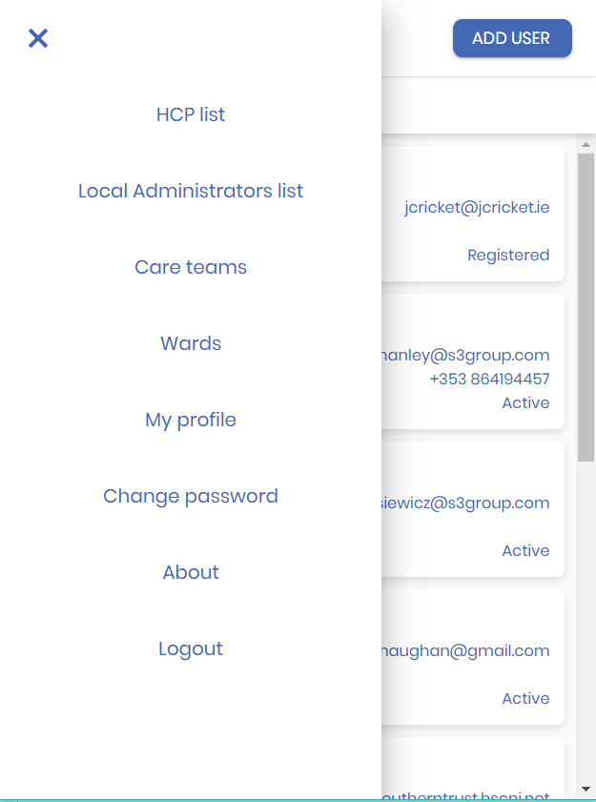
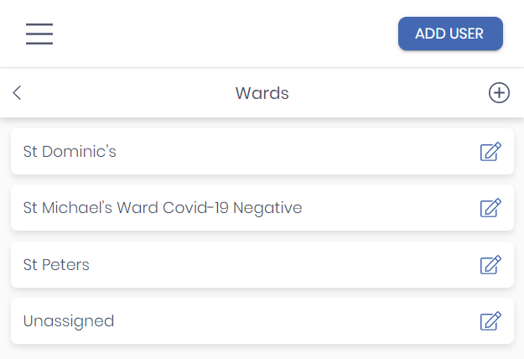
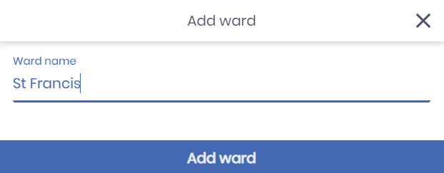
How do I setup wards in the Hospital
It I possible to setup wards so that patient’s location can be managed in Enodatis for COVID-19.
To add a Ward simply select the “Wards” option from the menu dropdown on the top-left of the screen.
You will be shown a list of the wards already setup for your hospital.
Tap the + icon to add a new Ward
Specify the name of the care team and tap ‘Add Ward’
To Edit the name of a care team simply select it from the list

Slide 8
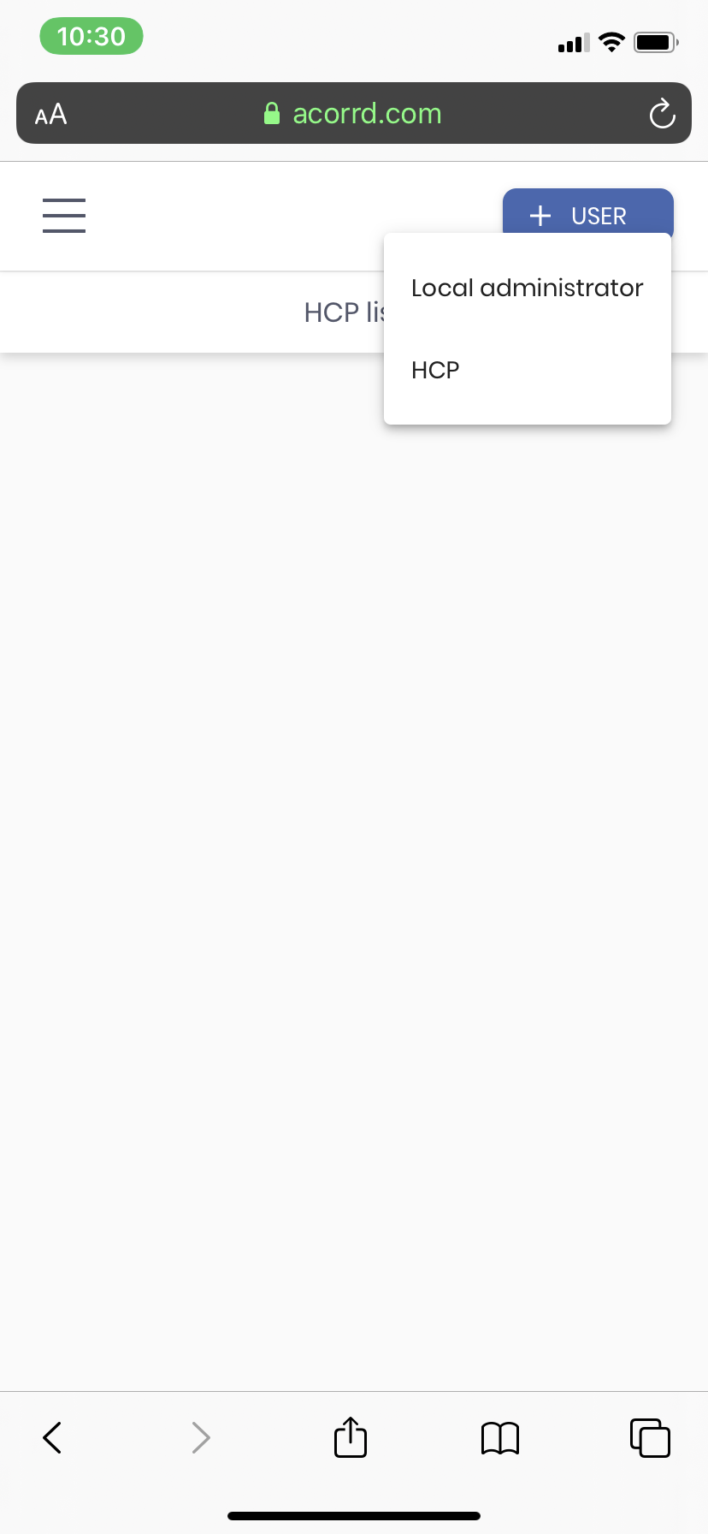
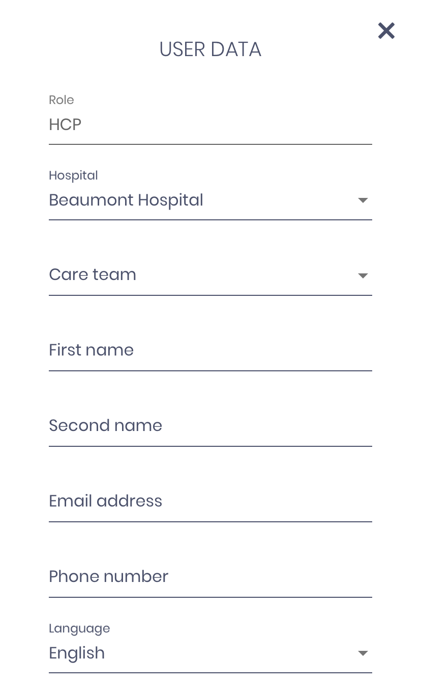
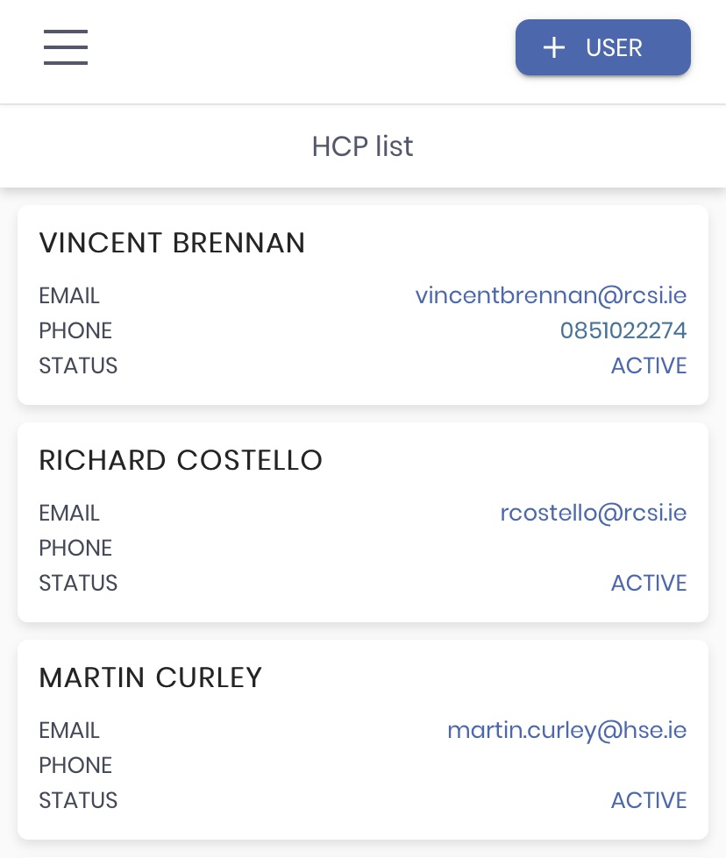


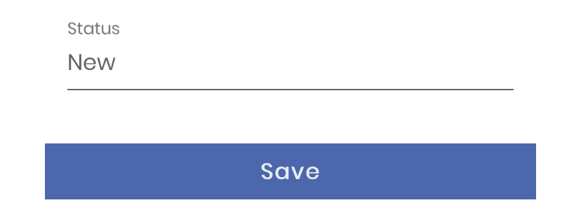

How do I Invite a HCP to Register
Clinicians can only use Enodatis for COVID-19 if they are invited to do so by a local administrator. Please verify the credentials of the HCP before performing the subsequent steps.
Tap the “+ User” button on the top-right of the screen. Then select “HCP” from the dropdown.
Select the initial Care Team assignment for the clinician.
Complete the registration fields. Please ensure that the email address is correct. Select “Save”.
An eMail invitation to create an account will be sent to the specified HCP with instructions about how to register. If a valid mobile number is provided an SMS invitation will also be sent to the HCP mobile.
If HCP invitation expires then it is possible to reissue it from the HCP profile.

Slide 9
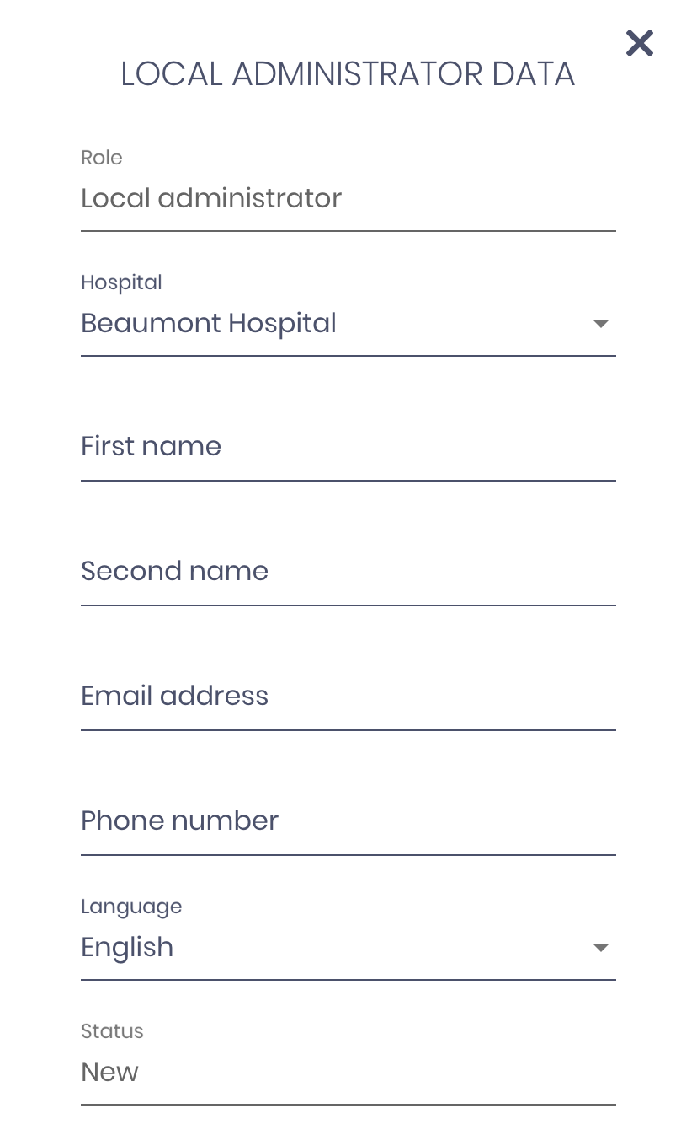
How do I Invite an additional Local Admin?
A local admin can also invite other local admins so that the tasks can be shared among multiple people if necessary.
Tap the “+ User” button on the top-right of the screen. Then select “Local Administrator” from the dropdown.
Complete the registration fields. Please ensure that the email address is correct. Select “Save”.
An eMail invitation to create an account will be sent to the specified administrator with instructions about how to register.
If the invitation expires then it is possible to reissue it from the clinician profile.

Slide 10
How do I get help?
For Clinical advice and guidance, consult with Senior Respiratory Clinicians
To get help with using Enodatis for COVID-19 and to report issues with Enodatis for COVID-19 please visit the service desk at https://servicedesk.enodatis.com or via email at
enodatis-itsupport@s3connectedhealth.com
To register as a clinician on Enodatis for COVID-19 then please contact the Enodatis for COVID-19 admin in your Hospital by emailing: enodatisadmin@<yourhospitaldomainname>
eg. enodatisadmin@beaumont.ie
If your hospital is not already registered but you would like to find out more or register to start using Enodatis for COVID-19 then please visit the service desk at https://servicedesk.enodatis.com

Slide 11


Enodatis for Covid-19 Manufacture Details
Enodatis for COVID-19 VER NO: 2.0.0
Symbols Found in Instructions or Enodatis for COVID-19 Application
10 2020
Symbol | Meaning | Symbol | Meaning
 | Legal manufacturer of the medical device |  | Date of manufacture of the medical device
 | There are accompanying instructions that should be read |  | Warning or caution statement
Silicon & Software Systems Ltd.
South County Business Park
Leopardstown
Dublin, D18 T9P8
Ireland
+353 1 563 2000
info@S3ConnectedHealth.com
A PDF version of this guide can be downloaded from: https://servicedesk.enodatis.com
Printed paper copies of this guide can be obtained by sending an email request to: enodatis-itsupport@s3connectedhealth.com

