Slide 1
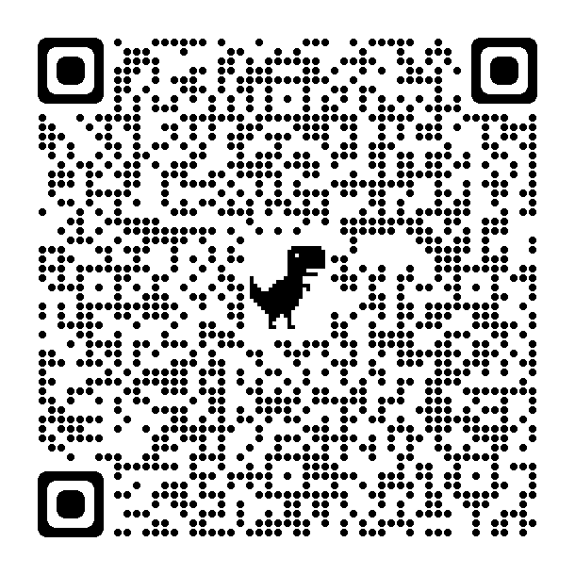


CNME Mayo / Roscommon introduces
NEW Online Application forms for Nurses and Midwives wishing to apply for Post Registration funding in 2024.
Please use QR Code on the right to download an application form or email: CNME.MayoRos@hse.ie

Slide 2
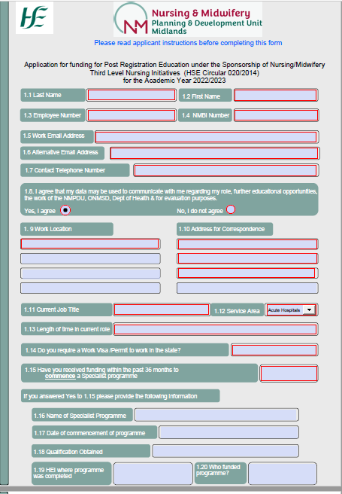
New Post Registration application form 2024
(5 pages) For courses at QQI Level 8 & 9
Applicant must complete all fields highlighted with a red border
Applicants must complete all mandatory fields on page
1 , 2, 3 & 4

Slide 3
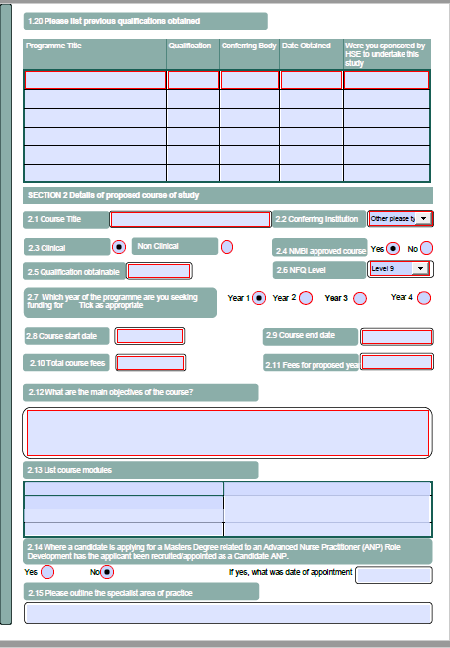
Page 2
Please note if all mandatory fields are not completed the form cannot be submitted for review

Slide 4
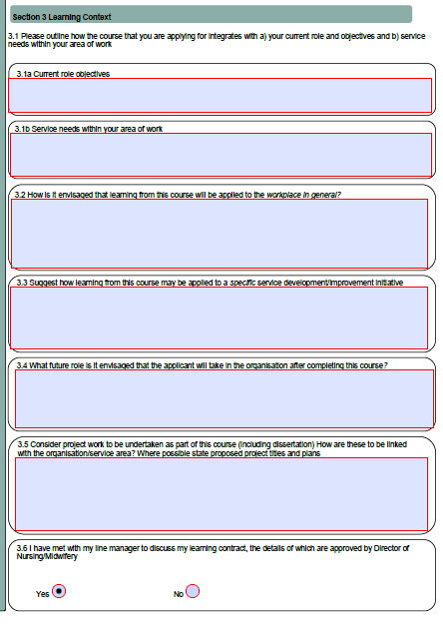
Page 3
Applicants must complete all mandatory fields on Page 3 Learning Context
& Page 4 Applicants Declaration of Understanding

Slide 5
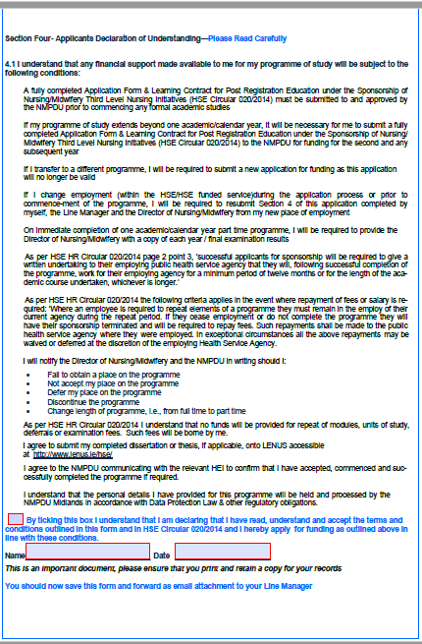
Page 4
Applicant must complete Page 4 Applicants Declaration of Understanding

Slide 6
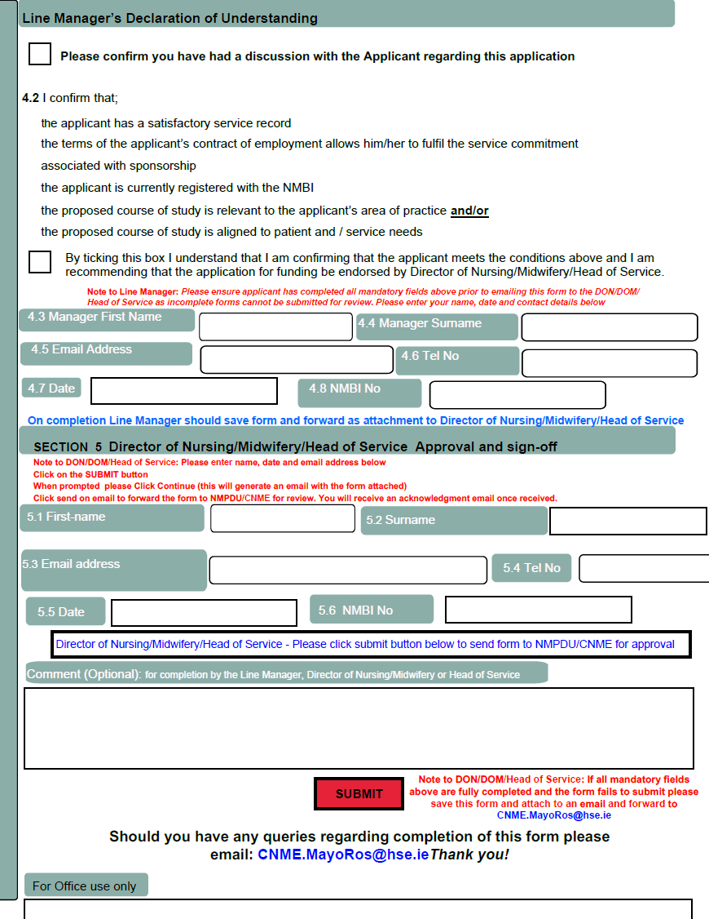
Page 5
The Line Manager must complete section 4.2 to 4.8 and email form to the Director of Nursing/Midwifery/ Head of Service
The Director of Nursing/Midwifery/Head of Service must complete section 5.1 to 5.6 and click on SUBMIT to send to CNME Mayo/Roscommon for review

Slide 7
Application forms
For a Post Registration Please use this QR code
This form is also available on the ONMSD Website
https://healthservice.hse.ie/about-us/onmsd/education-and-continuous-professional-development/cpd-for-nurses-and-midwives/apply-for-funding/cnme-mayo.html
Enquiries can be directed to CNME.MayoRos@hse.ie
Brought to you in partnership with the
National Health Library and Knowledge Service www.hselibrary.ie

