Slide 1
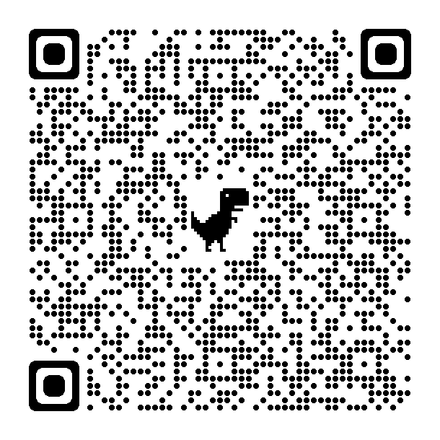
CNME Galway introduces NEW Online Application forms for Nurses and Midwives wishing to apply for Post Registration funding.
Please use QR Code on the right to download an application form or email: CNME.guh@hse.ie

Slide 2
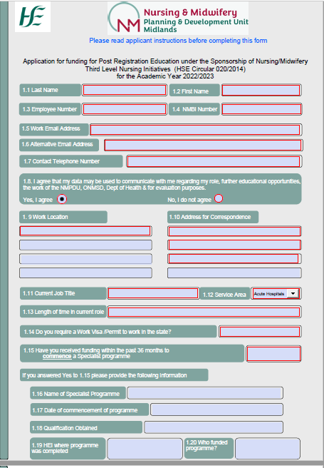
New Post Registration application form
(5 pages) For courses at QQI Level 8 & 9
Page 1
Applicants must complete all fields highlighted with a red border
Applicants must complete all mandatory fields on page
1 , 2, 3 & 4

Slide 3
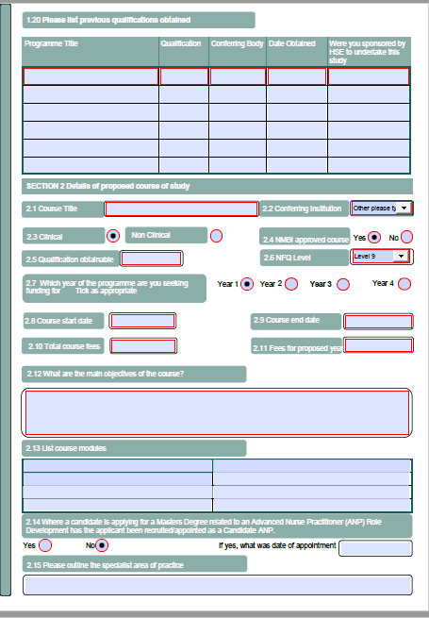
Page 2
Please note if all mandatory fields highlighted with a
red border are not completed the form cannot be submitted for review

Slide 4
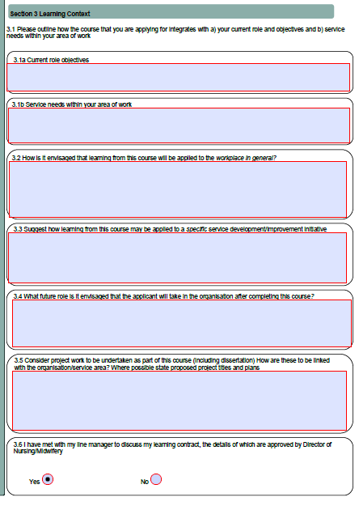
Page 3
Applicants must complete all mandatory fields with a red border on Page 3 Learning Context

Slide 5
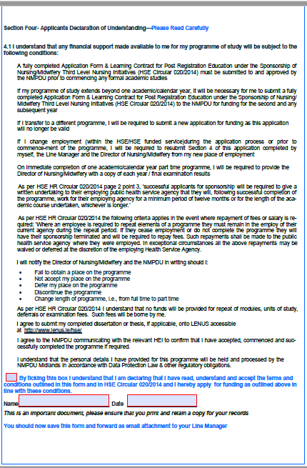
Page 4
Applicant must read Page 4 Applicants Declaration of Understanding,
and sign electronically

Slide 6
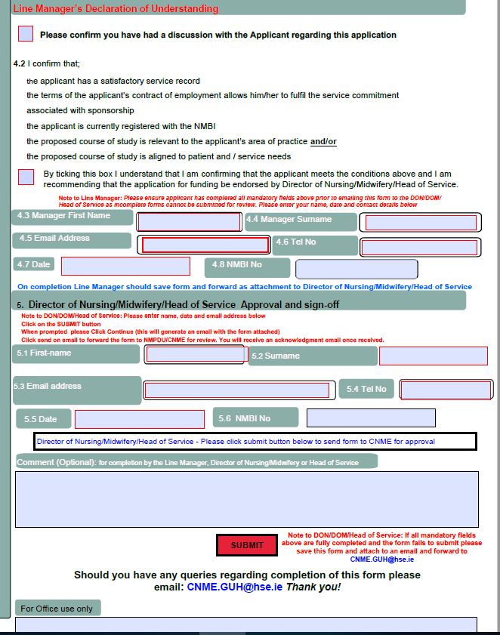
Page 5
The Line Manager must complete section 4.2 to 4.8 and email form to the Director of Nursing/Midwifery/Head of Service
The Director of Nursing/Midwifery/
Head of Service must complete section 5.1 to 5.6 and click on SUBMIT to send to CNME Galway for review

Slide 7
Application forms
For a Post Registration Form Please use this QR code
This form is also available on the ONMSD Website
https://healthservice.hse.ie/about-us/onmsd/cpd-for-nurses-and-midwives/apply-for-funding/cnme-galway.html
Enquiries can be directed to CNME.guh@hse.ie
Brought to you in partnership with the
National Health Library and Knowledge Service www.hselibrary.ie

